Slide 1
Choosing the Right Tool for the Job
Deborah Melkin
she/her
SQL Developer
Advisor360

Slide 2




Deborah
Melkin
she/her
SQL Developer
Worked with MS Data Platform for over 20 years
Speaker Idol Winner 2019
Microsoft MVP – Data Platform
Alter Ego = Amateur Musician
Advisor360
@dgmelkin
DebtheDBA.wordpress.com
dgmelkin@gmail.com

Slide 3






Code of Conduct
The PASS Data Community Summit conference is dedicated to providing a safe and harassment-free learning and networking environment for everyone. Harassment in any form is not tolerated.
Please report any concerns
Get in touch with the organizing team at help@passsummit.com
Read our full Code of Conduct
www.PASSDataCommunitySummit.com/code-of-conduct

Slide 4
Why talk about tools?
Many options are available.
We don’t always get a chance to explore what’s available in the middle of trying to get work done.
They can help us be more productive.

Slide 5
So, what are we trying to do?
a.k.a. Job functions

Slide 6
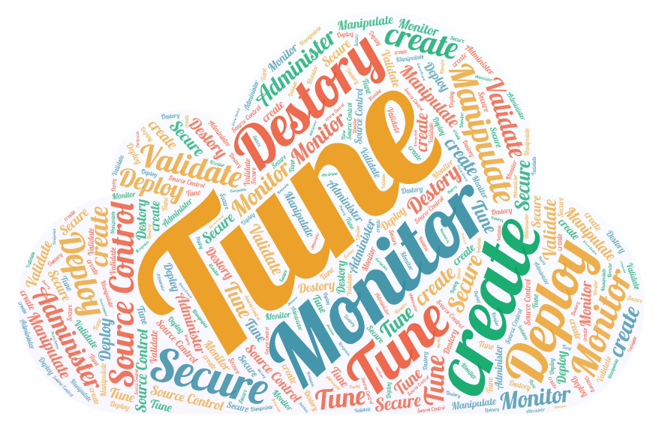
The “Data Lifecycle”:
Create
Tune
Monitor
Deploy
Secure
Source Control
Manipulate
Administer
Destroy
Validate
Notes:
The “Data Lifecycle”:
Create
Tune
Monitor
Deploy
Secure
“Source Control”
Manipulate
Administer
Destroy
Validate
Word Cloud - https://wordart.com/create

Slide 7
Let’s break it down differently…
Rinse
Repeat
Lather
Develop
Administer
Automate\Deploy

Slide 8
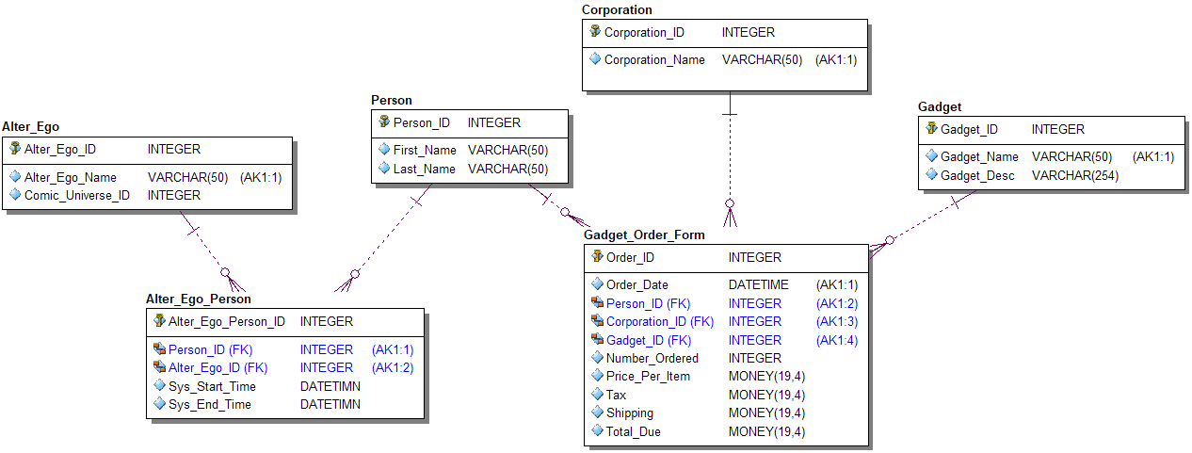
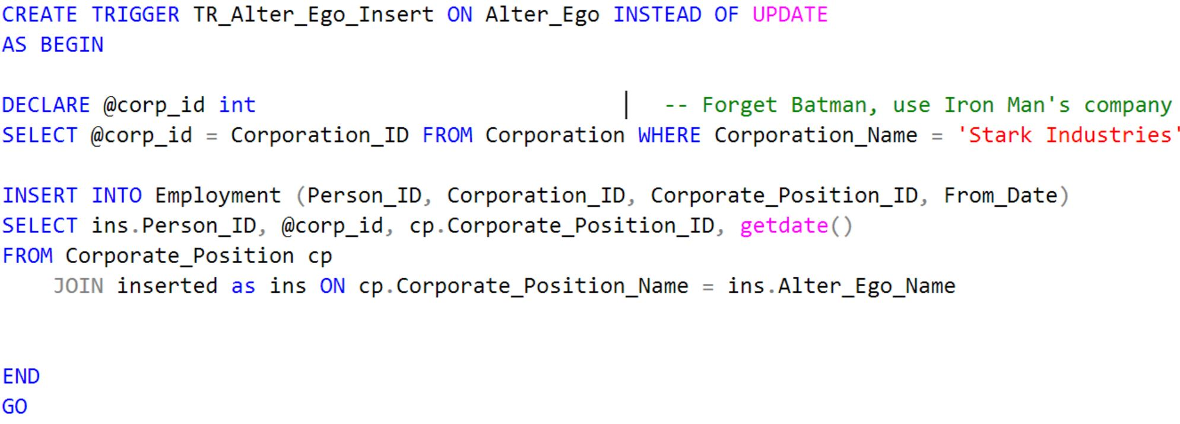
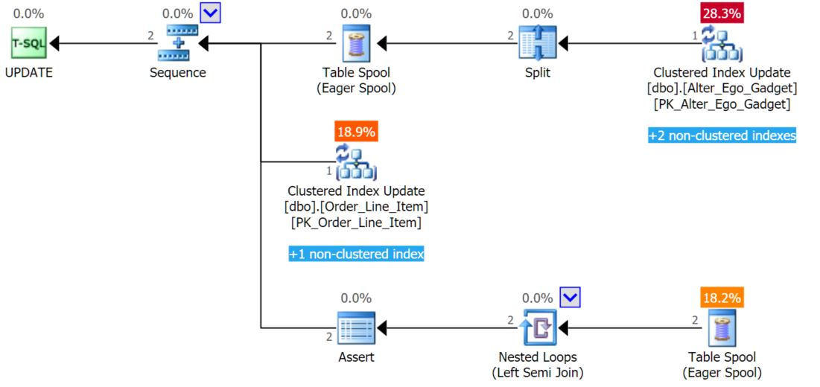
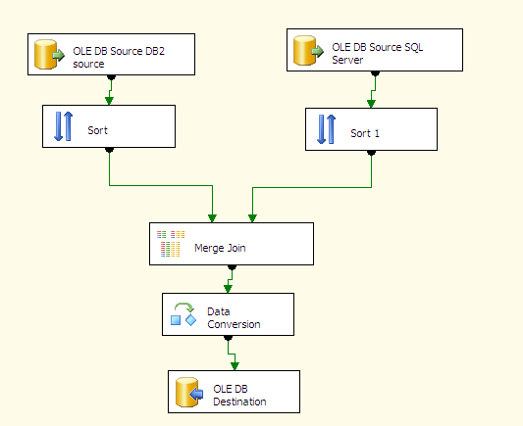

Develop
Create objects
Tables
Views
Stored Procs
Performance Tune
Execution Plans
ETL Loads
Reports
Notes:
ETL - This Photo by Unknown Author is licensed under CC BY-SA

Slide 9

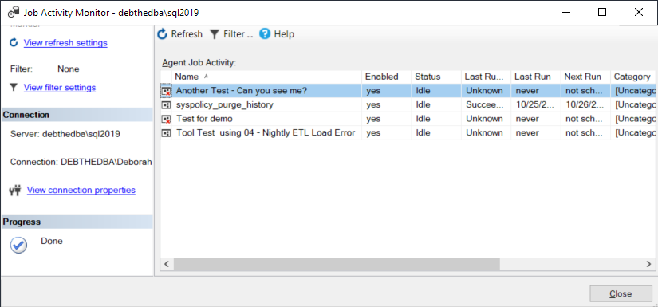
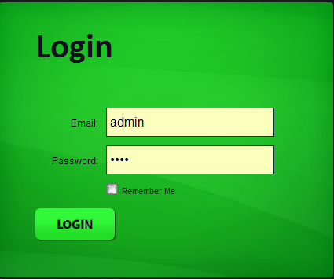
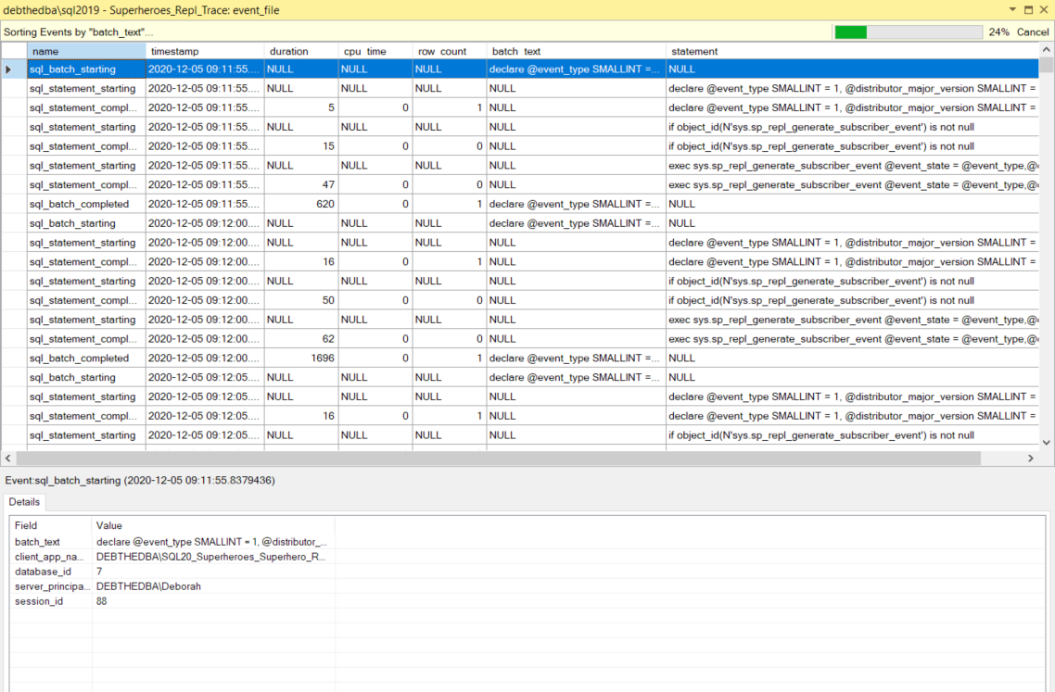
Administer
Configure
Backup and Restore
High Availability \Disaster Recovery
Security
Logins & Users
Jobs
Monitor
Notes:
Backup \Restore - This Photo by Unknown Author is licensed under CC BY-NC-ND
Login - This Photo by Unknown Author is licensed under CC BY-SA

Slide 10

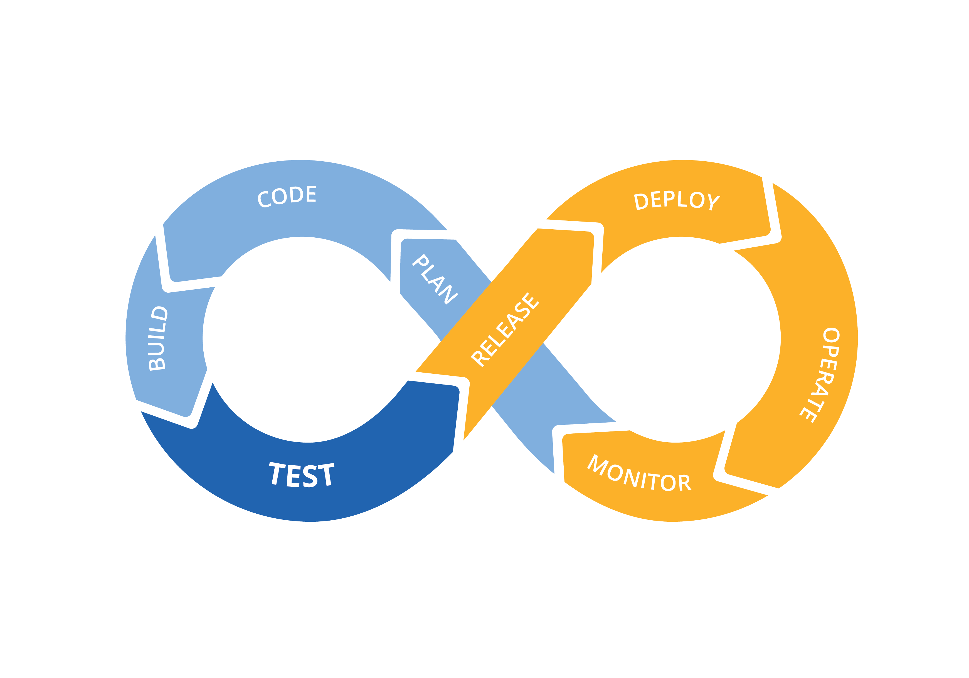
Automate
Release Process
CI/CD (Continuous Integration/Continuous Deploy)
Migration vs State Based (dacpacs\bacpacs)
Source Control
Runbooks
Notes:
GitHub - This Photo by Unknown Author is licensed under CC BY-SA
DevOps - This Photo by Unknown Author is licensed under CC BY-SA

Slide 11

So how do we decide which tools to use?
Let’s take a look….
This Photo by Unknown Author is licensed under CC BY-SA

Slide 12
Summary

Slide 13
Takeaways
If it starts with “Azure”, you will need the portal for some or all of the work.
If functionality is not there by default, check to see if there’s an extension that needs to be installed.
You may need more than 1 tool. That’s OK.
Where do you spend most of your time during the “data lifecycle”?
This will dictate the tools.

Slide 14
Resources
dbatools.io
Azure Data Studio GitHub
VS Code GitHub
https://vscode.dev/

Slide 15
Community Add-Ins
SSMS Tools Pack by Mladen Prajdić

Slide 16
Any questions? Let me know!
Deborah Melkin
@dgmelkin
debthedba.wordpress.com
dgmelkin@gmail.com

